Slide 1
Earnings Dispersion and the Cross-Section of Stock Returns
A Data-Driven Long-Short Strategy Based on Realized EPS Dispersion
By: Tanvi Johri

Slide 2
Why Earnings Dispersion?
Literature Context
APPROACH
Diether, Malloy & Scherbina (2002): Analyst forecast dispersion → lower returns→ Attributed to optimism bias + short-sale constraints
We ask a different question: “Do stocks with more volatile earnings subsequently earn higher returns?”
Our findings align with:
Zhang (2006): Investment-specific risk priced in returns
Pástor & Veronesi (2003, 2009): Higher uncertainty → higher risk premia
Bali, Cakici & Whitelaw (2014): Macroeconomic and fundamental uncertainty is positively priced
Conclusion: Volatile earnings may reflect real risk, not just investor disagreement — and thus justify a return premium.
Use historical EPS volatility (5-year realized dispersion): A backward-looking, accounting-based measure of fundamental uncertainty
Signal: Construct monthly long–short portfolios:
• Long: Firms with high earnings volatility
• Short: Firms with low earnings volatility
Trading Strategy Implementation:
• Apply volatility targeting to equalize risk across legs
• Adjust for transaction costs to reflect realistic implementation
Goal: Test whether realized earnings uncertainty predicts cross-sectional returns
Key Finding: High-volatility firms consistently outperform low-volatility firms→ Even after cost, Sharpe ratio > 1.1 and FF3 alpha ≈ 16% (t ≈ 2.0).
Why this matters: Traditional studies focus on expectational disagreement — we focus on realized uncertainty, which has distinct pricing implications

Slide 3
Data & Universe Construction
DATA SOURCES
DATA FILTERS
Compustat (Quarterly):
Net Income (NIQ)
Shares Outstanding (CSHOQ)
Used to compute EPS
CRSP (Monthly):
Stock returns, prices, shares (SHROUT)
Used to compute monthly portfolio returns
Use CRSP–Compustat Link Table to match gvkey–PERMNO
Include only firms with:
Price ≥ $5 (microcap filter)
Primary linkage (LINKPRIM = ‘P’)
≥ 5 valid annual EPS observations
Non-missing monthly return data
Final sample: ~3,500 firms, 500,000+ firm-months
Note:
We exclude firms with near-zero mean EPS to avoid inflated dispersion values No explicit survivorship bias correction — but filters reflect institutional feasibility

Slide 4


Constructing the Earnings Volatility Signal
EPS CALCULATION
DISPERSION SIGNAL
Start with quarterly net income (NIQ) and shares outstanding (CSHOQ)
Compute annual EPS:
Fill missing share data using CRSP December-end shares (SHROUT)
Exclude firms with near-zero mean EPS to avoid inflated dispersion values
For each firm-year, compute 5-year trailing EPS dispersion:
Minimum 5 valid annual EPS observations required
Assign annual dispersion value to each month within the same fiscal year
Interpreted as: A proxy for valuation uncertainty or disagreement in fundamentals

Slide 5
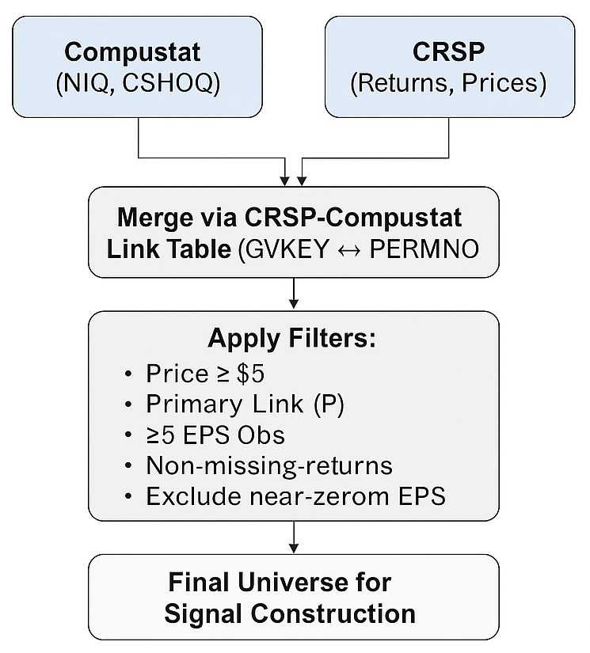
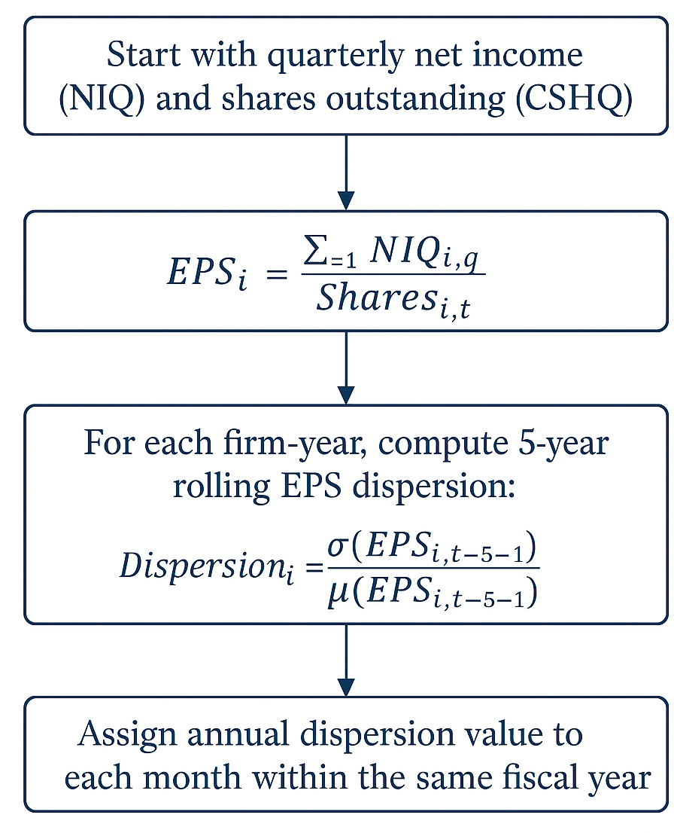
Universe & Signal Construction Workflows

Slide 6
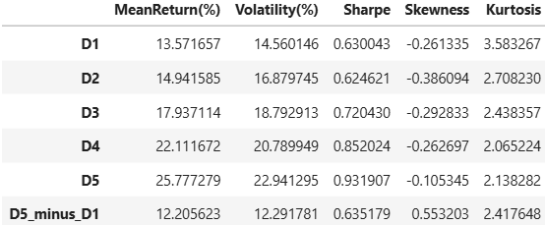
Signal & Portfolio Formation
Sort stocks into quintiles based on 5-year EPS dispersion
Construct a monthly long–short portfolio
Long D5 (high dispersion), Short D1 (low dispersion)
Equal-weighted and rebalanced monthly
Table below reports annualized stats using full-sample data:

Slide 7
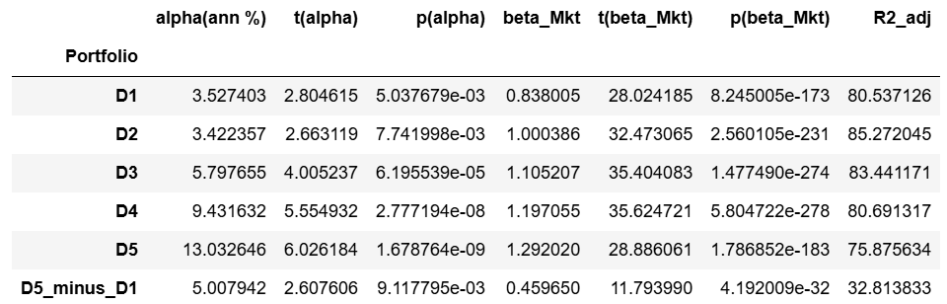
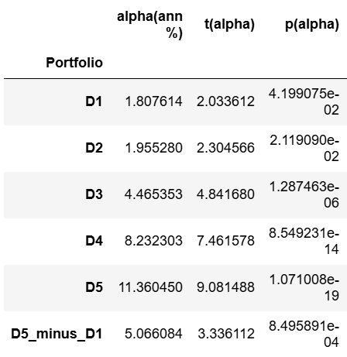
Signal’s Statistical Robustness (all years)
Regress returns of dispersion-sorted portfolios on CAPM and FF3 factors
Alphas increase monotonically from D1 to D5. D5–D1 spread earns ~5% alpha, statistically significant in both models
High t-stats and low p-values across portfolios confirm strong explanatory power
Dispersion signal delivers robust abnormal returns not explained by market, size, or value

Slide 8
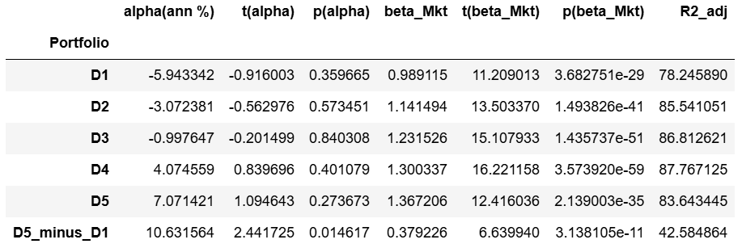
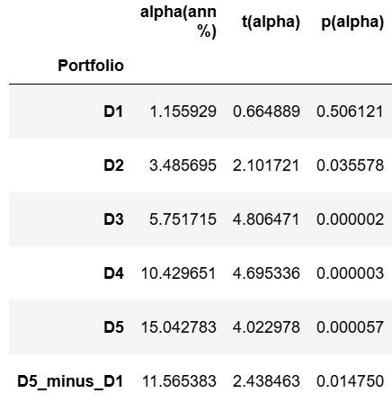

Signal’s Statistical Robustness (recent 5 years)
D5–D1 spread delivers strong performance: 10.6% CAPM alpha (t = 2.44), 11.6% FF3 alpha (t = 2.44)
High Sharpe (1.20), positive skew (0.66) confirm attractive, risk-adjusted return profile over recent 5 years

Slide 9
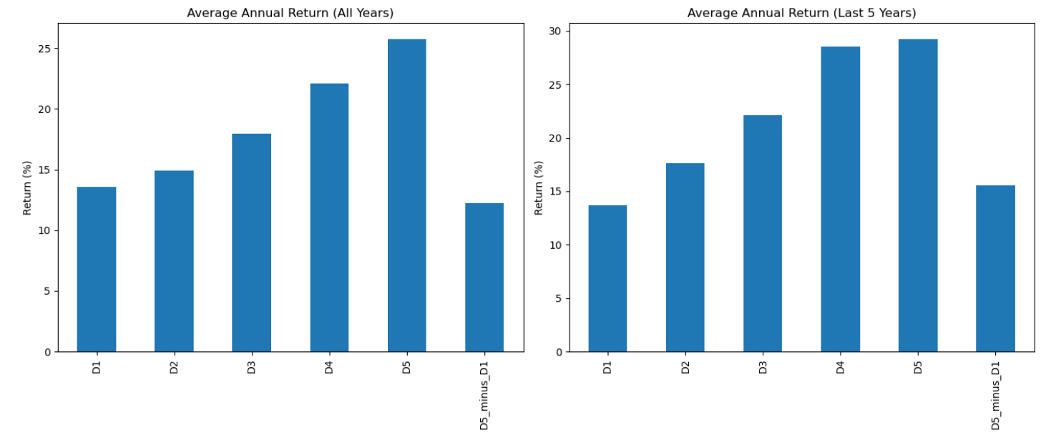
Monotonic Increase in Returns D1-D5

Slide 10
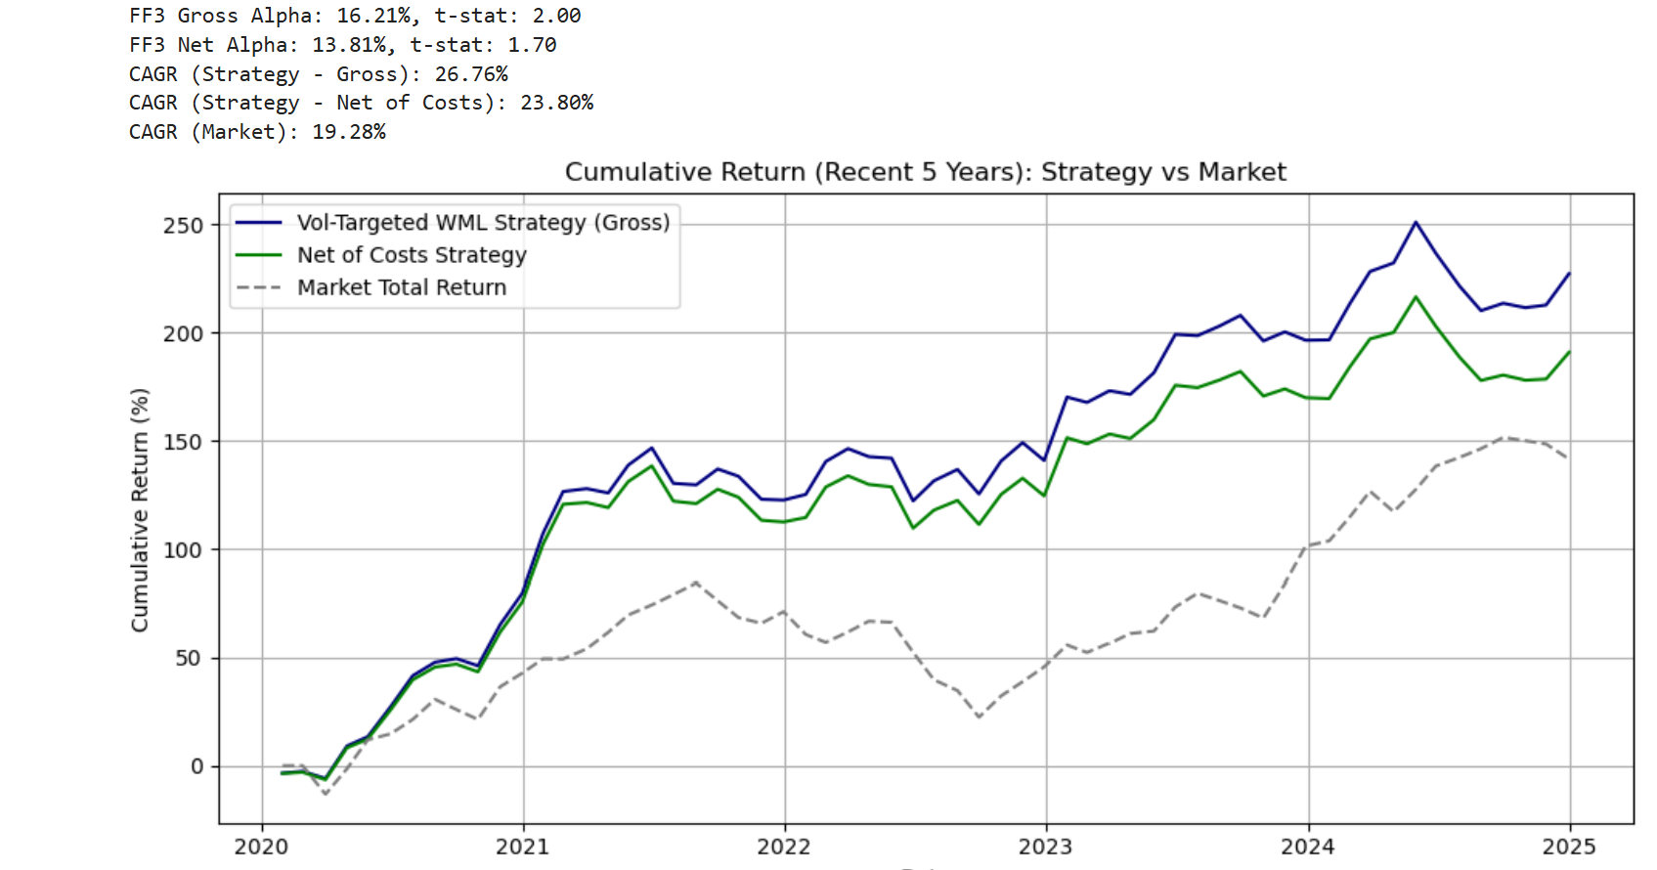
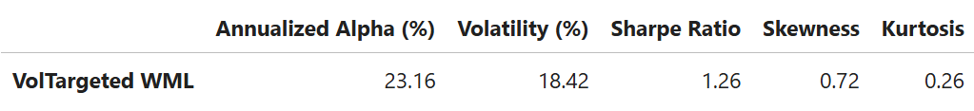

Does Our Trading Strategy Deliver?
Strategy outperforms market with CAGR of 26.8% gross, 23.8% net of costs
Delivers strong risk-adjusted returns: Sharpe ratio > 1.1, even after costs
FF3 alpha remains significant post-costs, confirming persistent, abnormal returns

Slide 11
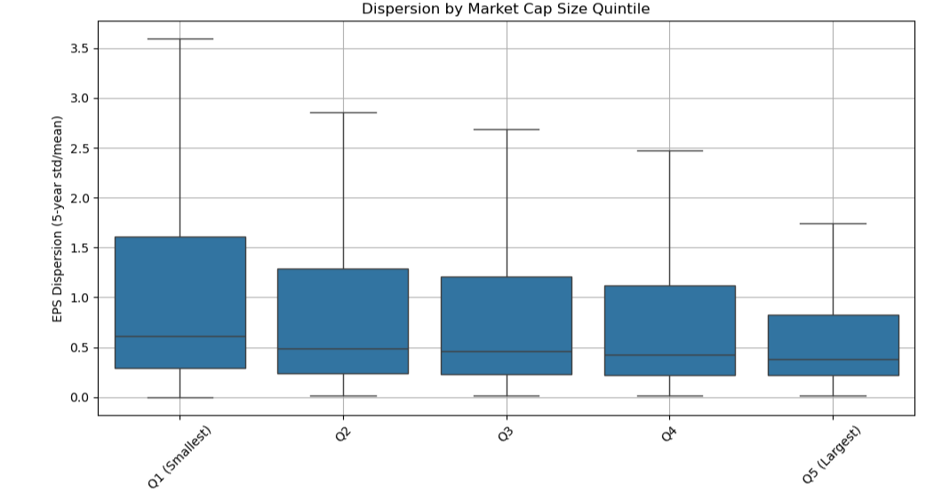
Dispersion By Market Cap
Larger firms tend to exhibit lower EPS dispersion, consistent with more stable earnings and lower fundamental uncertainty.

Slide 12
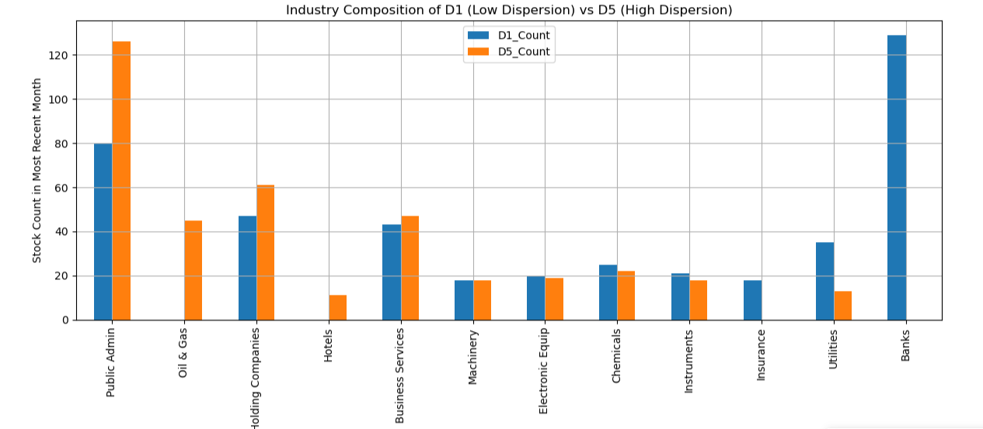
Industry Composition — D1 vs D5
High dispersion portfolios (D5) are tilted toward Biotech, Pharma, and Public Admin, while low dispersion portfolios (D1) include Utilities and Banks.

Slide 13
Why Does It Work?
Risk-based explanation
Behavioral explanation
High EPS volatility → reflects real economic risk
Unpredictable earnings
Business cyclicality
Operational leverage
Investors demand risk premium to hold these stocks
Resulting in higher expected returns
Investors may avoid complex/volatile stocks:
Ambiguity aversion
Institutions screened them out
High-volatility firms often = speculative upside
Early-stage tech / biotech
Prices may lag fundamentals, creating alpha opportunity
Whether due to compensation for risk or systematic investor biases, high EPS dispersion is a persistent return driver.

Slide 14
Key Differentiators
This contrast shows how the source of uncertainty—beliefs vs fundamentals—critically shapes pricing outcomes.
Aspect | Diether Et Al. (2002) | Our Strategy
Signal Type | Forward-looking forecasts | Backward-looking fundamentals
Outcome | Lower Returns | Higher Returns
Interpretation | Mispricing due to Beliefs | Compensation for Real Risk

Slide 15
Limitations & Robustness Checks
Limitations
robustness
Data Requirements: 5 years of clean EPS data → excludes younger firms
Signal Lag: Backward-looking → may miss rapid shifts
No Trading Cost Adjustment: Volatile stocks may have wider spreads, lower liquidity
Potential Survivorship Bias: Delisted firms underrepresented
Price Filter ($5+): Reduces microcap noise
Outlier Control: Exclude firms with near-zero mean EPS
Consistent Spread: Long-short returns persist across time
While there are caveats, basic filters and consistent returns make the signal robust and economically meaningful.

Slide 16
Conclusion: A Simple, Powerful Signal
What We Did
Built a long-short strategy based on realized EPS dispersion
Avoided reliance on analyst forecasts or subjective sentiment
Constructed quintile portfolios, rebalanced monthly
What We Found
High-earnings-volatility firms consistently outperform
This contradicts traditional belief-based signals (Diether et al.)
Strategy is grounded in real risk or neglected stock behavior
Why It Matters
Scalable, intuitive, transparent — based on public accounting data
Works even for small/mid-cap stocks without analyst coverage
Highlights the importance of signal design in asset pricing
Realized uncertainty ≠ mispricing — some of it is risk that commands premium.

